Slide 1
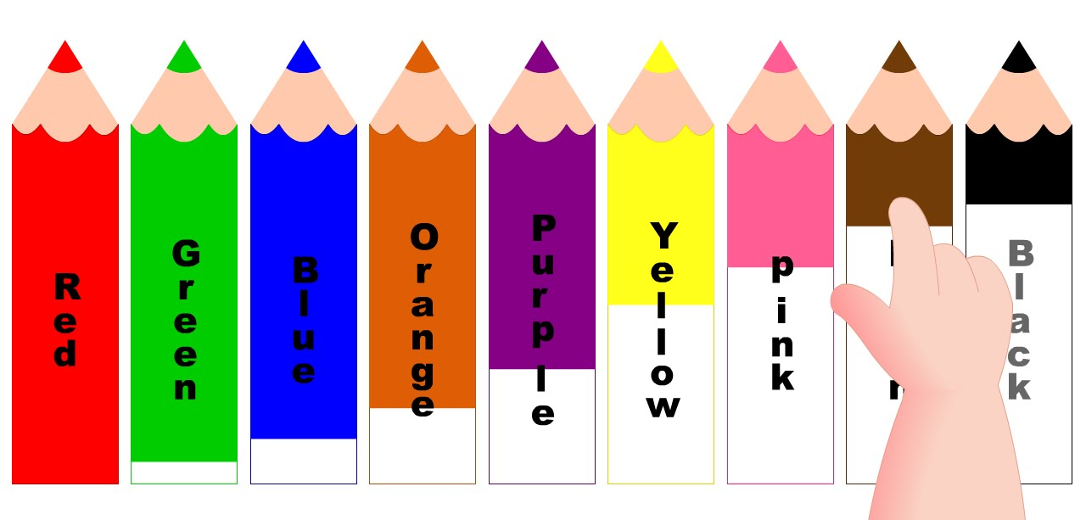
COLOURS = barvy

Slide 2
WHAT IS THIS?
It´s a red clock.

Slide 8
RED

Slide 9
ORANGE

Slide 10
BLUE

Slide 11
PINK

Slide 12
YELLOW

Slide 13
GREEN

Slide 14
YELLOW
PINK
GREEN
RED
ORANGE
BLUE

